Slide 1


BMS COLLEGE OF ENGINEERING
(Autonomous Institute, Affiliated to VTU, Belagavi)
DEPARTMENT OF MACHINE LEARNING
(UG Program: B.E. in Artificial Intelligence and Machine Learning)
Course : Python Programming
Course Code: 22AM4AEPPM
ALZHEIMER’s DIAGNOSIS A Deep Learning CNN based approach for detecting Alzheimer’s Disease using Brain MRI Scans
Phase -1: Python Project Presentation
Date: SEPTEMBER 1ST, 2023
Presented By,
Student Name & USN :
PRIYANKA.S-1BM21AI095
PAPIREDDIGARI RENUSREE-1BM21AI081
SAHANA GP -1BM21AI108
Faculty In-Charge:
Seemanthini maam
Assistant Professor
Department of Machine Learning
BMS College of Engineering

Slide 2

ABSTRACT
Alzheimer's disease (AD) is a progressive neurodegenerative disorder characterized by cognitive decline and memory loss. Early and accurate diagnosis of AD is crucial for effective treatment and intervention.
The proposed method involves leveraging neuroimaging data, such as magnetic resonance imaging (MRI) scans, to develop a reliable and automated AD diagnostic system.
Initially, the MRI scans are pre-processed to enhance image quality and remove noise. Subsequently, a CNN architecture is designed and trained using a large dataset of both AD and non-AD images.
The trained CNN model is then employed for AD diagnosis by inputting new, unseen MRI scans. The model applies its learned knowledge to extract relevant features from the input images and generates a diagnostic output indicating the likelihood of AD presence.
The diagnostic output can be further validated and interpreted by medical professionals, assisting them in making informed decisions regarding patient care and treatment strategies.

Slide 3
INTRODUCTION
Alzheimer’s disease is a brain disorder that slowly destroys memory and thinking skills and, eventually, the ability to carry out the simplest tasks. In most people with the disease.
The damage initially takes place in parts of the brain involved in memory, including the entorhinal cortex and hippocampus. It later affects areas in the cerebral cortex, such as those responsible for language, reasoning, and social behavior. Eventually, many other areas of the brain are damaged.
Those with the late-onset type symptoms first appear in their mid-60s. Early-onset Alzheimer’s occurs between a person’s 30s and mid-60s and is very rare. Alzheimer’s disease is the most common cause of dementia among older adults.
Analyzing magnetic resonance imaging(MRI) is a common practice for Alzheimer’s disease diagnosis in clinical research . Detection of Alzheimer’s is exacting due to the similarity in AD MRI data and standard healthy MRI data of order people.

Slide 4
REQUIREMENTS
Implementation of prediction of Alzheimer's disease using MRI scans.
DATASET
The input to the model consists of neuroimaging data, such as structural MRI scans or PET scans, that capture brain images of individuals. These images serve as the primary source of information for the diagnosis.
HARDWARE
A machine equipped with adequate computational power, including a GPU is vital for training deep learning models efficiently.
SOFTWARE
Data Acquiring and Preprocessing :ImageDataGenerator (TensorFlow), SMOTE (Imbalanced-Learn)
Model Training and Evaluation :TensorFlow, OpenCV, Scikit-Learn, NumPy, Joblib, Keras, Pandas, Matplotlib
Executing platform: Google colab or jupyter notebook

Slide 5
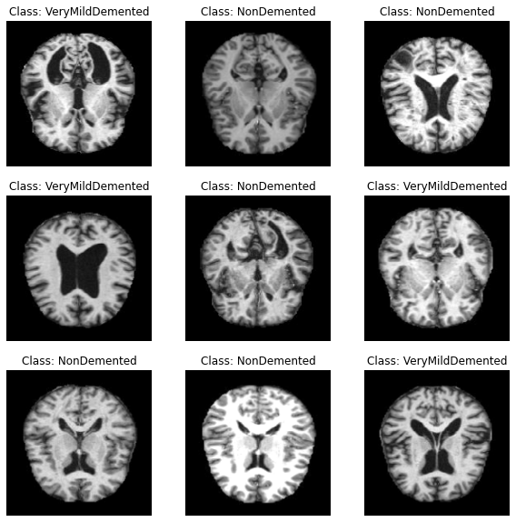
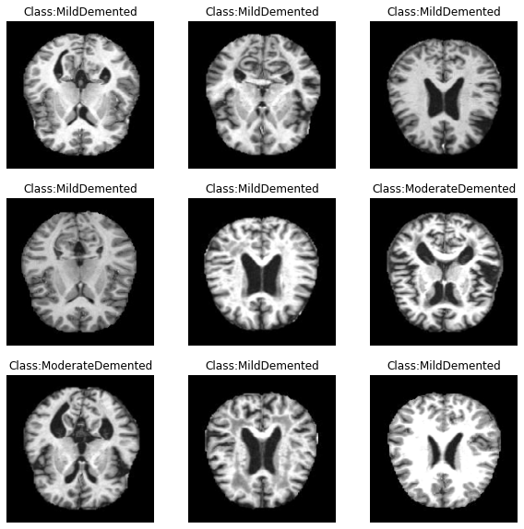
MRI SAMPLES

Slide 6
TOOLS AND TECHNOLOGY
Deep learning Libraries: Keras for Model Development
Keras: A user-friendly, open-source deep learning library, enabling rapid experimentation and prototyping of neural network architectures.
TensorFlow Backend: Keras employs TensorFlow as its backend, ensuring seamless integration with a powerful and flexible deep learning framework.
Feature Extraction: InceptionV3 is an image recognition model with 42 layers, that has been shown to attain greater accuracy.the model itself is made up of convolutions, average pooling, max pooling, concatenations,dropouts and fully connected layers .
Collaborative Development: Google Colab
Cloud Computing Platforms: Services like AWS, Google Cloud, and Azure offer GPU-accelerated instances for training deep learning models.

Slide 7
Architecture of InceptionV3 Model
Inception V3 is an image recognition model with 42 layers that has been shown to attain greater accuracy.
The model itself is made up of convolutions , average pooling ,max pooling, concatenations , dropouts , and fully connected layers.
Major Features of InceptionV3 architecture:
Factorizing Convolutions
Factorizing Into Smaller Convolutions
Factorizing Into Asymmetric Convolutions
The aim of factorizing Convolution is to reduce the number of connections/parameters without decreasing the network efficiency.
Auxiliary Classifier
The objective of using an Auxiliary classifier is to improve the convergence of very deep neural networks . Auxiliary classifiers act as a regularizer in Inception V3 model architecture.
Regularization refers to technique used to calibrate machine learning models in order to minimize the adjusted loss function and prevent overfitting or underfitting.
3. Efficient Grid Size Reduction
The Inception V3 model used several techniques for optimizing the network for better model adaptation.
It has higher efficiency and less expensive
it has deep network compared to V1 &V2 models , but its speed isn’t compromised.

Slide 8
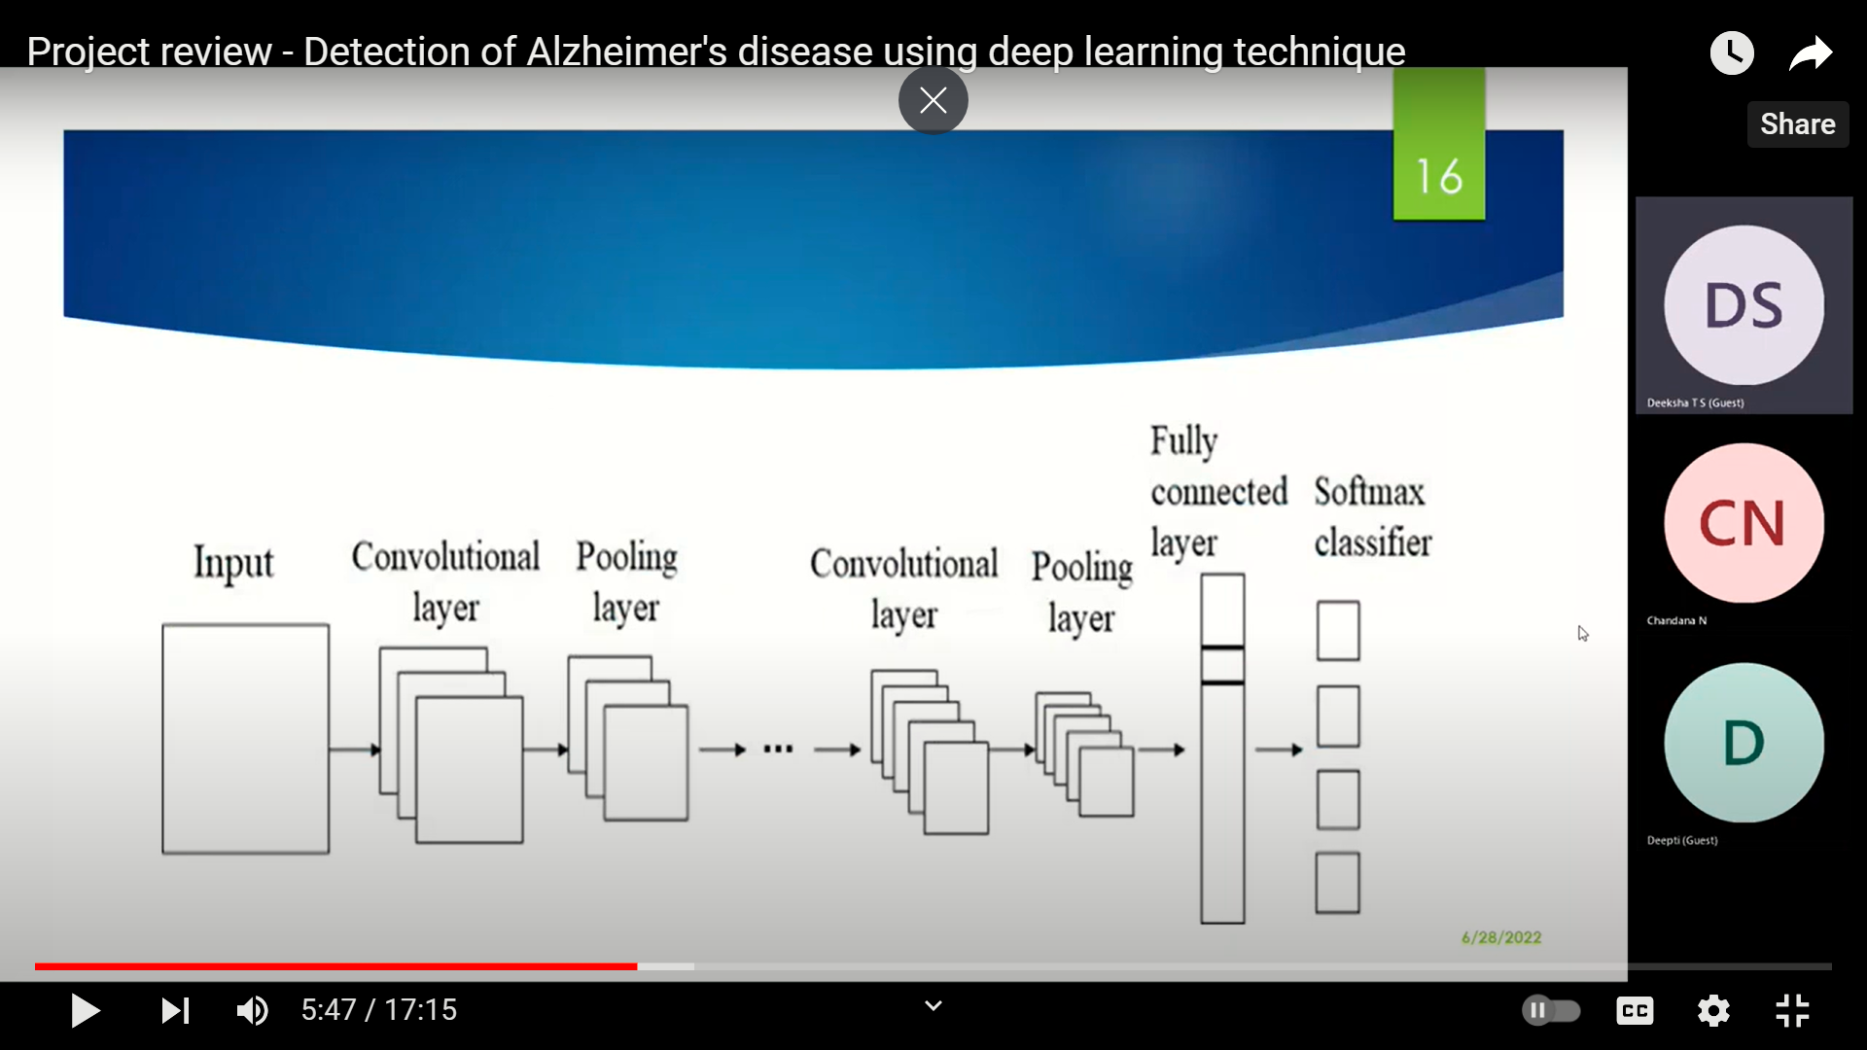
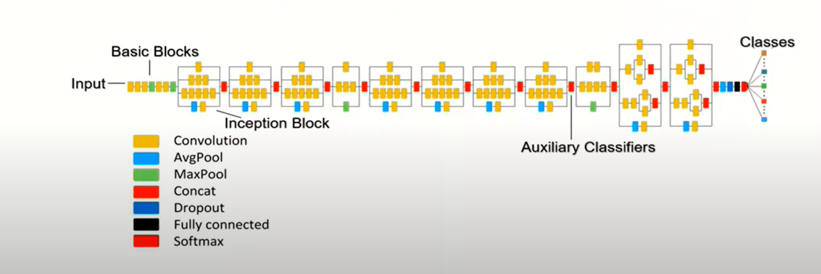
CNN
ARCHITECTURE OF PROPOSED SYSTEM

Slide 9
WORKFLOW/WORK PRINCIPLES
Data Acquisition: Gather neuroimaging data from various sources, such as MRI (Magnetic Resonance Imaging) scans, PET (Positron Emission Tomography) scans, or fMRI (functional MRI) scans. Ensure the data includes both Alzheimer's disease patients and healthy individuals for comparison.
Preprocessing: This preprocessing step involves tasks such as skull stripping, spatial normalization, intensity normalization, and noise reduction. These steps aim to remove irrelevant or noisy information and make the data consistent for further analysis.
Train-Test Split: Split the labelled data into training and testing sets. Typically, a certain percentage of the data is reserved for testing (e.g., 20-30%), while the remaining data is used for training the CNN model.
CNN Model Architecture Selection: Choose an appropriate CNN architecture for Alzheimer's diagnosis, such as VGGNet, ResNet, or InceptionNet. Consider the complexity of the architecture, model interpretability, and computational requirements while making the selection.

Slide 10
WORKFLOW/WORK PRINCIPLES
Model Training: Train the selected CNN model on the training dataset. This involves feeding the pre-processed neuroimaging data into the CNN model and optimizing the model parameters to minimize the classification error. The optimization process typically employs techniques such as backpropagation and gradient descent to update the model weights.
Model Evaluation: Evaluate the trained CNN model on the testing dataset to assess its performance. Measure the classification metrics such as accuracy, precision, recall, and F1 score to quantify the model's diagnostic capability. The evaluation provides an estimation of how well the model can generalize to unseen data and perform in real-world scenarios.
Regularization Techniques: Apply regularization techniques to prevent overfitting and enhance the generalization ability of the CNN model.

Slide 11
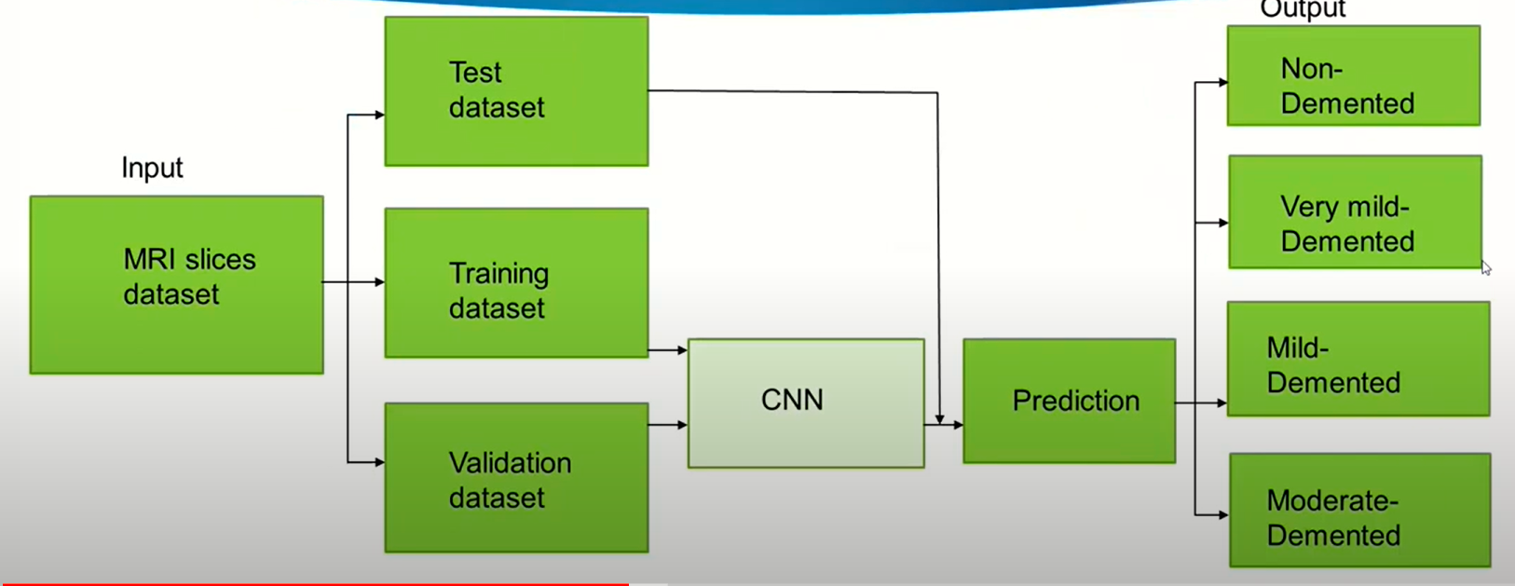
DATAFLOW DIAGRAM:

Slide 12
CONCLUSION
Our project was successfully implemented using Inception V3 architecture and achieved better accuracy . The Model developed was successfully able to detect and classify Alzheimer’s disease into stages-Non-Demented , Very Mild Demented and Moderate Demented.
Alzheimer's disease is a prevalent neurological illness that affects the elderly. As a result, early discovery is critical for adequate treatment and to avoid mishaps. Using deep learning, this effort assists in the automated identification of Alzheimer's disease. The primary purpose of this research is to devise practical method for people to take the required and appropriate safeguards against developing Alzheimer's disease. If a brain MRI scan is available, we may use this initiative to make its diagnostic accessible to everyone.
Deep Learning is a fast expanding area, and its use in the healthcare industry can be very beneficial to patients. Deep neural networks, particularly CNNs, can give useful information 4 for diagnosing Alzheimer's disease. Picture processing, particularly image categorization, is better served by CNN.
This model uses brain MRI data to forecast Alzheimer's Disease affected-brain vs. a normal ageing brain, and it is able to do so with more accuracy. Our suggested network might be extremely useful in detecting early-stage Alzheimer's disease.

Slide 13
THANK YOU

